Slide 1

The New Rotarian Passport
Developed by The Rotary Club of Irvine, California
Graphic design and layout by

Slide 2
PASSPORT COVER OPTIONS
STANDARD COVER (left)
Features Rotary International logo and Rotary quote.
“Rotary” is shown in quotes to emphasize this is not a passport to the organization, but to the experience and relationships we enjoy in Rotary.
QUOTE ON STANDARD COVER (FRONT):
“Rotary is without reality until we translate it into our lives and the lives of others. In short, you and I are Rotary.”
J. Edd McLaughlin 1960
© Rotary Club of Irvine. All Rights Reserved.

Slide 3
PASSPORT COVER OPTIONS
CUSTOM CLUB OR DISTRICT COVER
Customize anything on the cover
Change the background color
Change the passport title
Feature your club or district logo
Specify either a Welcome message or the Rotary quote of your choice
RESOURCES FOR ROTARY QUOTES
PDF with 100 Rotary Quotes
Rotary Quotes of the Week
© Rotary Club of Irvine. All Rights Reserved.

Slide 4
WHY THE PASSPORT?
Reduces confusion and information overload for new and current members
Allows new members to take bite-sized pieces of the pie as they experience Rotary
Answers FAQ’s of new members in a series of short discussions spanning several months
New members are not left to their own devices to discover Rotary
Members are guided by a mentor, who introduces them to club leaders
Club leaders engage and coach, so the new member experience is welcoming and pleasant
© Rotary Club of Irvine. All Rights Reserved.

Slide 5
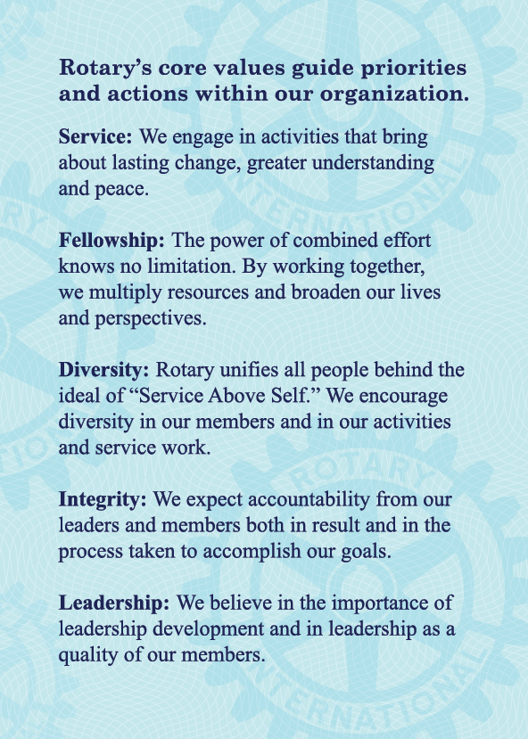
CORE VALUES COME FIRST
Provide a quick reference to the values that define us as Rotarians.
Gives Rotarians a pocket size reference as they learn and introduce their families and colleagues to the ideals or Rotary
Introduces new members to the core tenants of the Rotary brand
Focus new and current members on guiding priorities as they grow as Rotary leaders
Easily communicate expectations for Rotarian speech and behavior
© Rotary Club of Irvine. All Rights Reserved.

Slide 6
ENGAGE MEMBERS
The Passport is:
A tool for new Rotarians to explore the structure and inter-workings of:
  The Rotary Club
  The Rotary District
  International Programs
  The Rotary Foundation
A tool for leaders to engage new members
New members meet with their Mentor, then:
Discover the club vision
Master Rotary account administration
Learn about club projects
Engage their network with Rotary
Discover the Rotary Foundation
Participate in projects and social activities
Give feedback about their member experience
© Rotary Club of Irvine. All Rights Reserved.

Slide 7
CLUB DISCOVERY
The Passport mimics many traditional ‘blue badge’ activities while guiding new and current members in mutual discovery.
Club leaders and members learn about the new Rotarian
Each leader shares opportunity for the new member to engage in projects that match the members’ interests
Leaders gain understanding of member passions
Sharing of ideas helps the club improve existing projects while increasing members’ feelings of relevance and value
© Rotary Club of Irvine. All Rights Reserved.

Slide 8
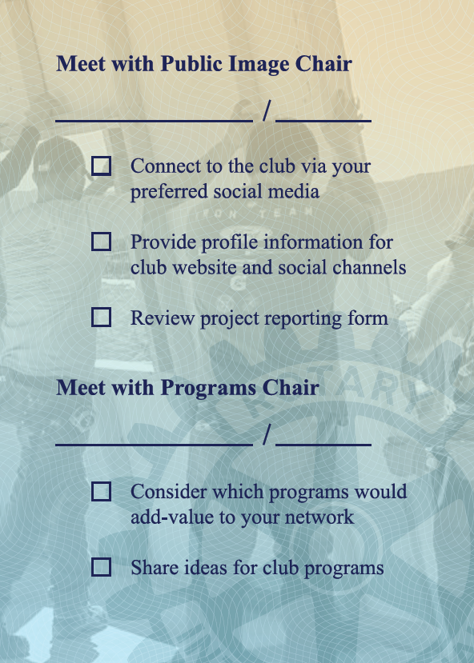
FACILITATE LEADERSHIP
The Passport bridges engagement gaps by outlining talking points for international service, public image, and club programs.
Familiarize new Rotarians with a better understanding of international projects
Encourage giving, project leadership, and partnerships with a full understanding of grants and idea sharing tools
Add value by highlighting each member on social media channels
Improve program processes and relevance by speaking with members about the potential for new programs
© Rotary Club of Irvine. All Rights Reserved.

Slide 9
FOUNDATION CLARITY
The Passport guides introductory discussions about the Rotary Foundation.
Additional tools are recommended as discussion supplements
Most recent TRF Annual Report
End Polio Now materials
Your Rotary Legacy brochure
Paul Harris Society brochure
  North America | International
Rotary Direct enrollment form
Present simplified information regarding recognition levels that makes it easy for new Rotarians to understand Foundation giving
© Rotary Club of Irvine. All Rights Reserved.

Slide 10
FULL SCALE ENGAGEMENT
The Passport keeps Rotarians engaged with typical fellowship activities, involvement in project leadership, and a facilitates a complete understanding of the Rotary organization.
Members join to serve their community; retain new members and increase attendance by engaging them in project leadership right away
All lists and backgrounds can be modified by choosing the Fully Custom option
District number is available for printing on customized Passports
© Rotary Club of Irvine. All Rights Reserved.

Slide 11
MEMBERSHIP GROWTH
The Passport encourages new members to invite guests and give feedback about their Rotary experience.
Engages with new Rotarians to prompt inclusion of your Rotary Club in professional networking conversations
iLoyal has programmed an online Rotary member survey that is customizable and available for all clubs to assess perceptions
Contact ray@iLoyal.com to get your club set-up
Two ‘notes’ pages provided to aid Rotarians with recall of their conversations and important thoughts
© Rotary Club of Irvine. All Rights Reserved.

Slide 12
PASSPORT COVER OPTIONS
CUSTOM COVER FOR DISTRICT (left)
Features Rotary.org and your District website
Options to consider:
Other Rotary resource page
Club website
Your choice of Rotary quote (if space available)
QUOTE ON STANDARD COVER (BACK):
“Friendship is a natural and willing servant. There is no reason why the great power of friendship should not be harnessed to do its part in the world’s work.”
Paul Harris (1912 Rotary Convention)
© Rotary Club of Irvine. All Rights Reserved.

Slide 13


To order for your club:
IrvineRotary.org/passport
Custom design, layout, printing, and shipping provided by
Proceeds earmarked for support of
Rotary Foundation Global Grants

